Slide 1
YouTube Data Harvesting and Warehousing Using MongoDB, SQL And Streamlit
This project aims to develop a user-friendly Streamlit application that utilizes the Google API to extract information from any YouTube channel, stores the retrieved channel data to MongoDB Data Lake, migrate the channel data to a SQL database and displays the SQL query results in the Streamlit app to get more insights on the data collected.

Slide 2
Problem Statement
The problem statement is to create a Streamlit application that allows users to access and analyze data from multiple YouTube channels. The application should have the following features:
Ability to input a YouTube channel ID and retrieve all the relevant data (Channel name, subscribers, total video count, playlist ID, video ID, likes, dislikes, comments of each video, etc) using Google API.
Ability to collect data for up to 10 different YouTube channels and store them in the MongoDB data lake by clicking a button.
Migrate the channel data from MongoDB to the SQL database.
Ability to search and retrieve data from the SQL database using different search options, including joining tables to get channel details.

Slide 3
Technolgies used
Python
Google Api Client
MongoDB (NoSQL)
MySQL (SQL)
Pandas
Streamlit

Slide 4
Approach
Set up a Streamlit app: Streamlit is a great choice for building data visualization and analysis tools quickly and easily. We can use Streamlit to create a simple UI where users can enter a YouTube channel ID, view the channel details, and select channels to harvest and migrate to the databases.
Connect to the YouTube API: We need to use the YouTube API to retrieve channel and video data. We can use the Google API client library for Python to make requests to the API.
Store data in a MongoDB data lake: Retrieved data from the YouTube API is stored in the MongoDB data lake. MongoDB is a great choice for a data lake because it can handle unstructured and semi-structured data easily.

Slide 5
Preprocessing Data : Using Pandas to preprocess the data before storing it to the SQL Database. Also used Pandas to preprocess the SQL database queried results, before displaying it on the streamlit UI.
Migrate data to a SQL data warehouse: Collected data for multiple channels can be migrated from MongoDB to a SQL data warehouse.
Query the SQL data warehouse: Using SQL queries to join the tables in the SQL data warehouse and retrieve data for solving some general questions.
Display data in the Streamlit app: Finally, you can display the retrieved data in the Streamlit app. You can use Streamlit's data visualization features to create charts and graphs to help users analyze the data.

Slide 6
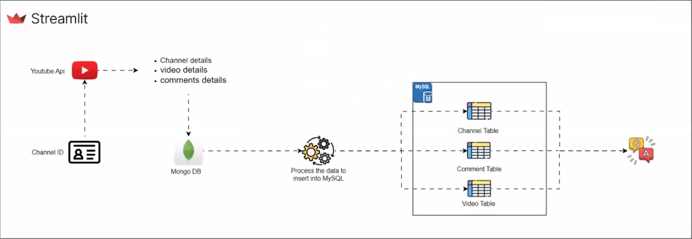
Flow Chart

Slide 7
Thank You!

